Slide 1
Community Based Prevention Services – Strategic Prevention Framework
Notes:
Thank you for joining us for today’s presentation.

Slide 2
Mission of OFMQ
OFMQ is a not-for-profit, consulting company dedicated to advancing healthcare quality. Since 1972, we’ve been a trusted resource through collaborative partnerships and hands-on support to healthcare communities.

Slide 3
What is RCORP?
Rural Communities Opioid Response Program
A $298 million multi-year initiative started in 2018 by the Health Resources and Services Administration (HRSA) aimed at reducing the morbidity and mortality of substance use disorder (SUD), including opioid use disorder (OUD), in rural communities at the highest risk for SUD.

Slide 4
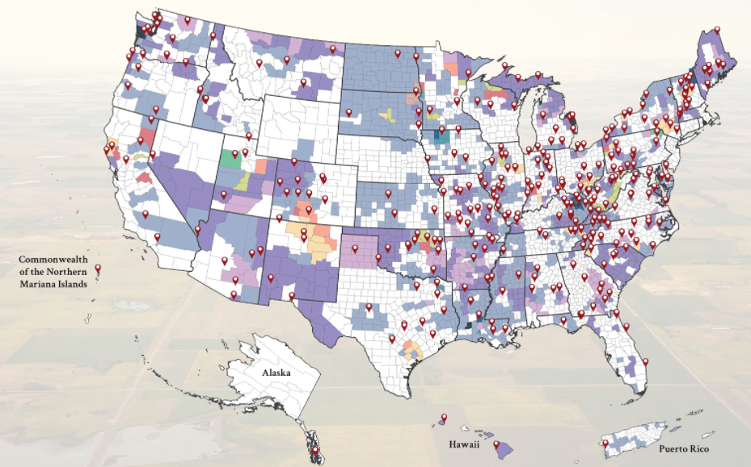
Map of RCORP Grantees

Slide 5
SCOPE-OK
RCORP Planning III and Implementation III grantee
Strategic Focus Areas:
Access to Treatment
Resource Availability
Workforce Enhancement
Data accessibility and Tracking
Meet the 3rd Monday of each month at 4PM
To be added to the meeting please email: Dflood@ofmq.com

Slide 6
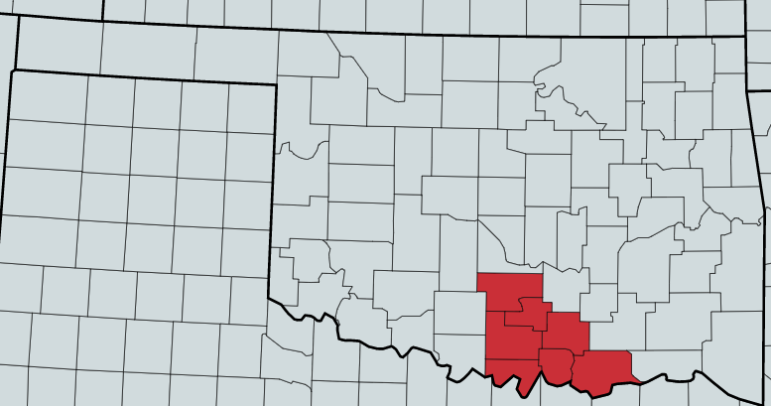
SCOPE-OK Service Area
Targeting 7 counties in south central/ I-35 corridor region
Bryan
Carter
Garvin
Johnston
Love
Marshall
Murray

Slide 7
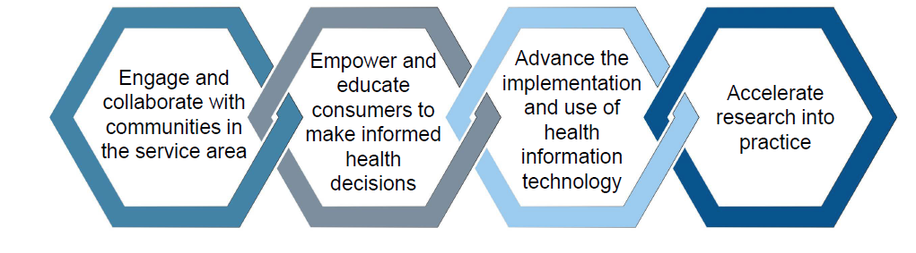
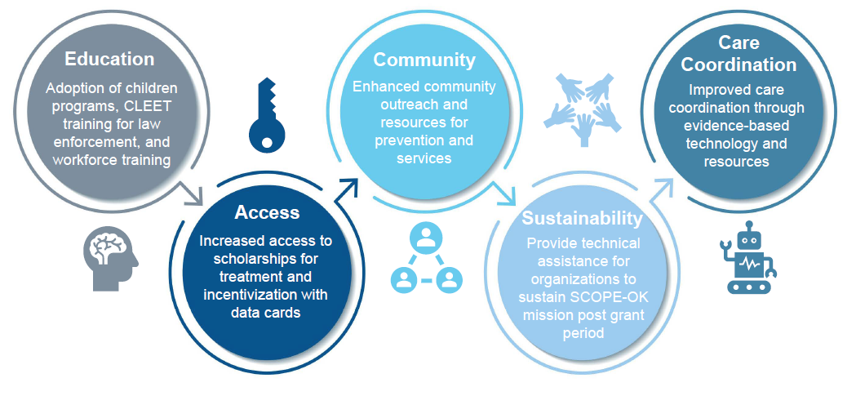
SCOPE-OK Goals and Outcomes
Goals
Our goals centralize around increasing access to care and collaboration of resources for SUD/OUD prevention, treatment, and recovery.
Long Term Outcomes

Slide 8
Community Based Prevention Services – Strategic Prevention Framework
Notes:
Next slide is speaker bio

Slide 9
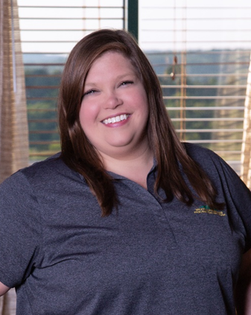
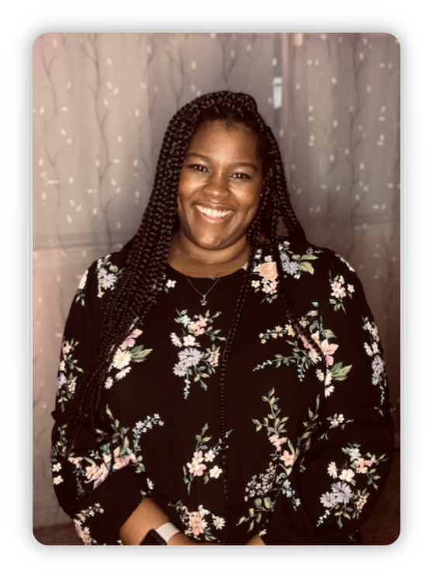
Lisa Jackson, Community Based Coalition Coordinator for Carter Co Substance Abuse Prevention Committee Jayci Enerson, WMPN Ardmore Director Chelsey Stevenson, Community Based Coalition Coordinator for CCSAPC/PASS for Garvin County
Lisa is a Certified Prevention Specialist and has been with WMPN for 5 years. She has worked on 9 grants in southern Oklahoma addressing substance use and abuse of marijuana, prescription drugs, alcohol, and stimulants.
Jayci is a Certified Prevention Specialist and has been with WMPN for 5 years. She has worked on 11 grants in southern Oklahoma addressing substance use and abuse of marijuana, prescription drugs, alcohol, and stimulants.
Chelsey is employed by the Wichita Mountains Prevention Network (WMPN). She is working on becoming a Certified Prevention Specialist and has been with WMPN for 3.5 years. Chelsey has worked on 9 grants in southern Oklahoma addressing substance use and abuse of marijuana, prescription drugs, alcohol, and stimulants.
Notes:
Our speakers for today are: read title and bio
Lisa share her screen for presentation

Slide 10
This project is supported by the Health Resources and Services Administration (HRSA) of the U.S. Department of Health and Human Services (HHS) as part of an award totaling $1,000,000 with zero percentage financed with non-governmental sources. The contents are those of the author(s) and do not necessarily represent the official views of, nor an endorsement, by HRSA, HHS, or the U.S. Government. For more information, please visit HRSA.gov.
Notes:
End if at 1 hour time slot or use additional slides re: OFMQ

